Slide 1
Data 1 - MSZ
(A)
(B)

Slide 2
Data 1 - MIZ
(A)
(B)

Slide 3
Data 2 - MSZ
(A)
(B)

Slide 4
Data 2 - MIZ
(A)
(B)

Slide 5
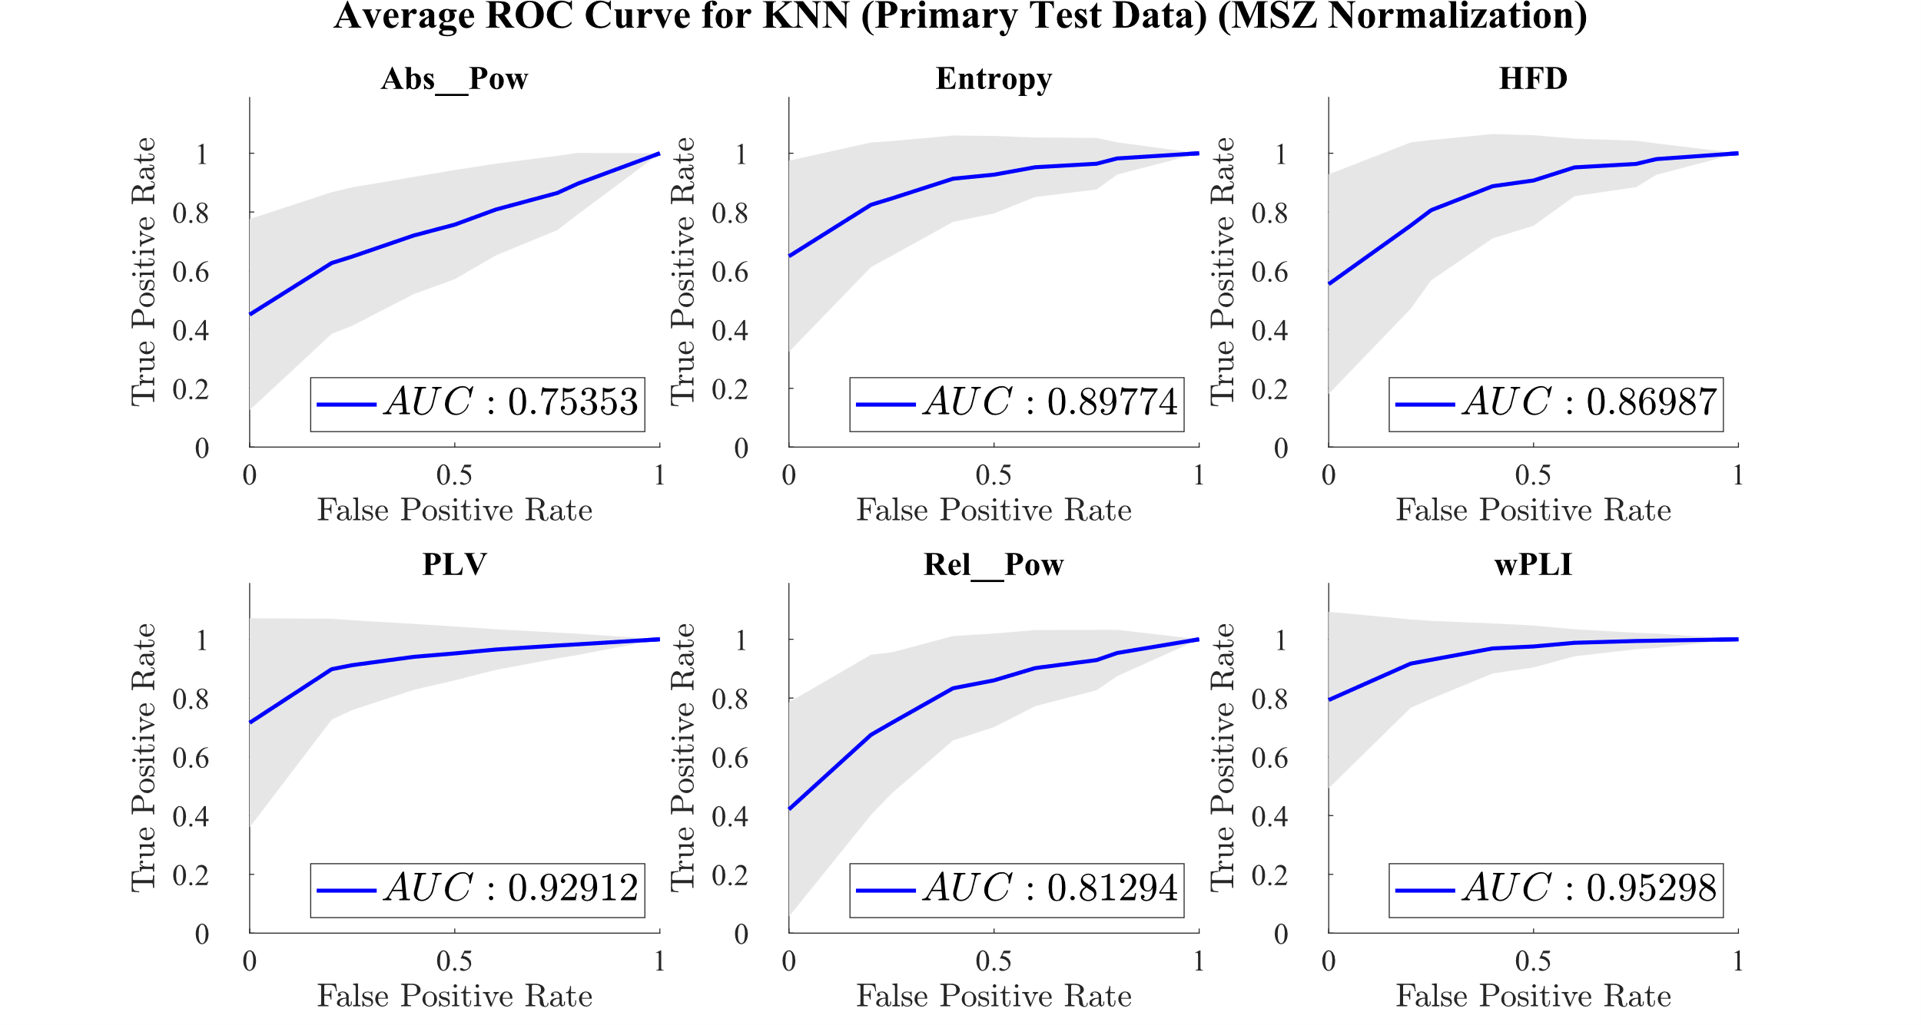
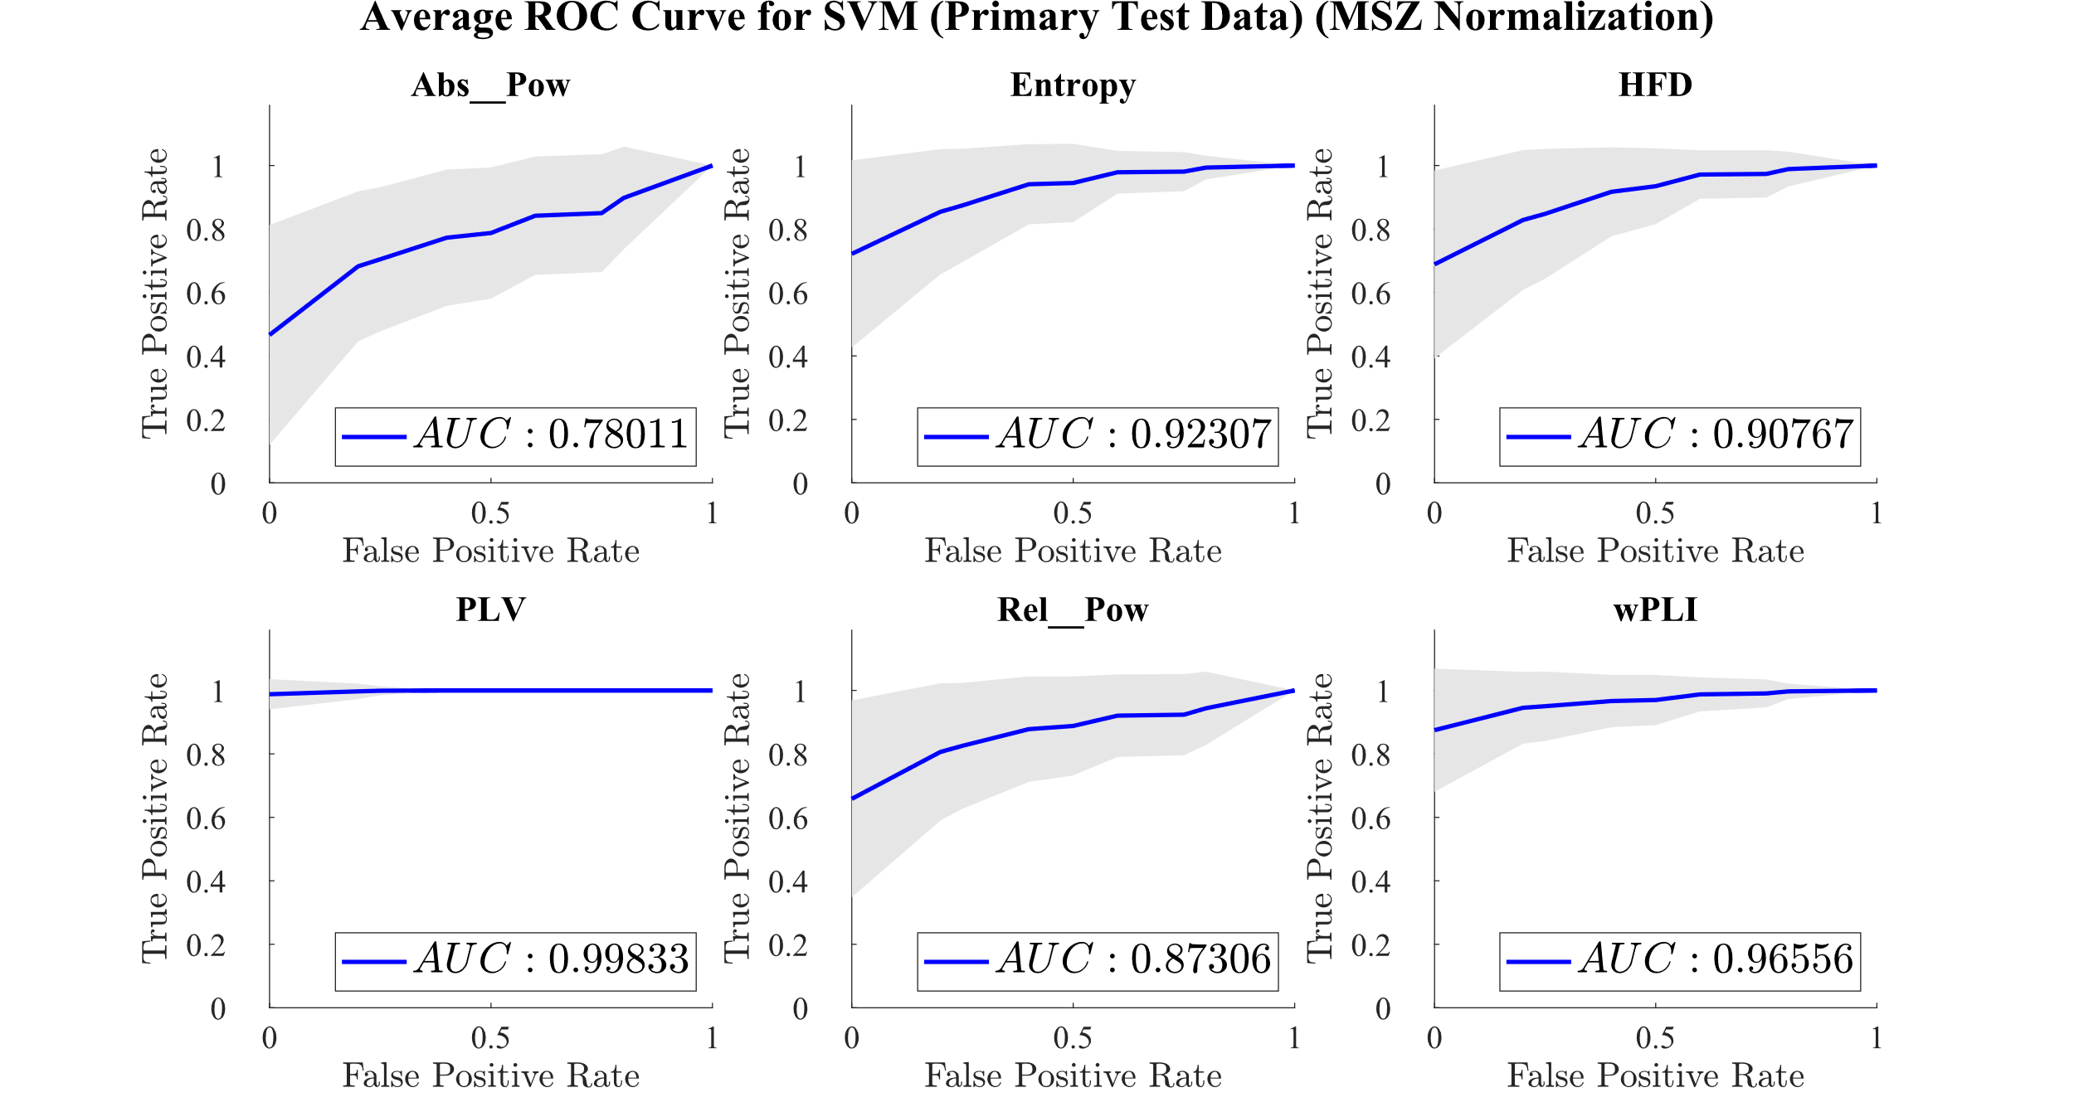

Slide 6
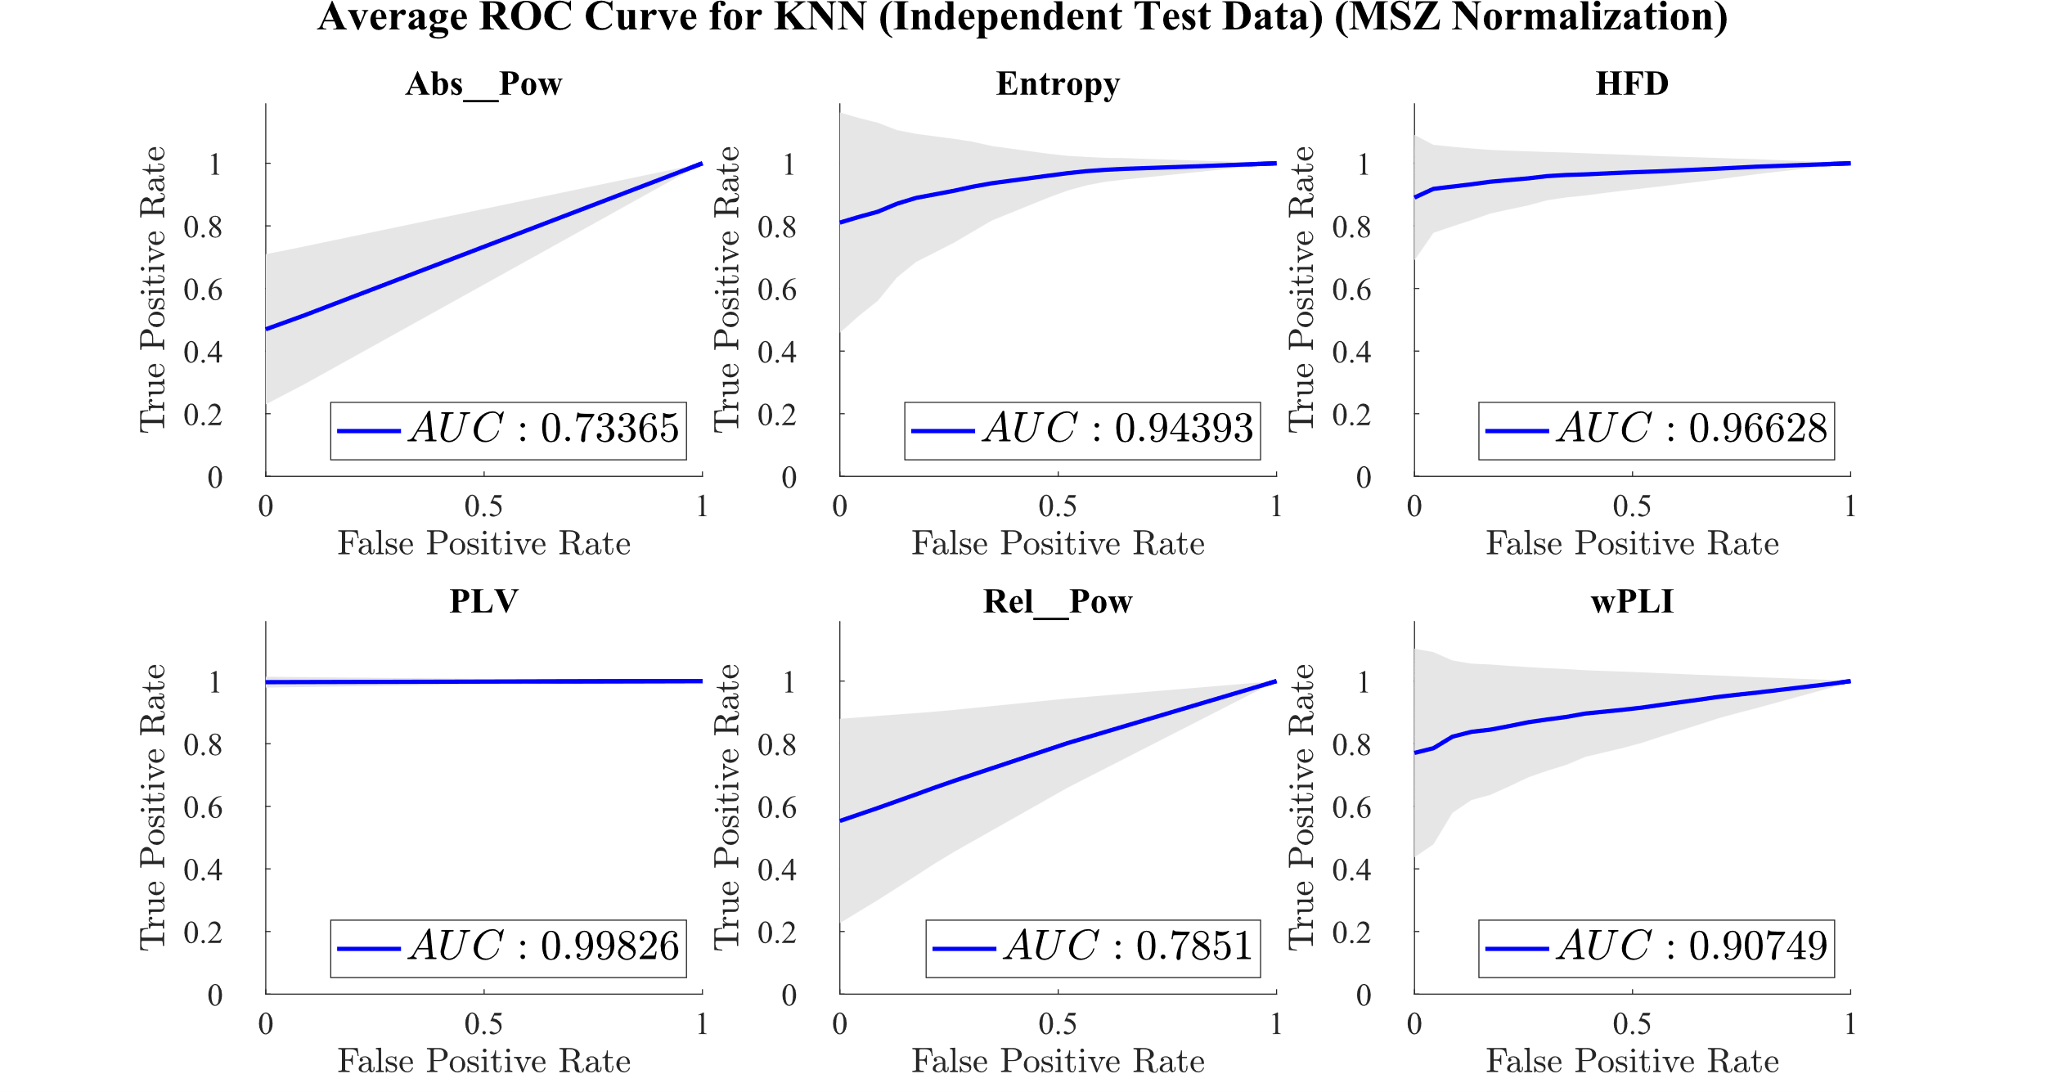
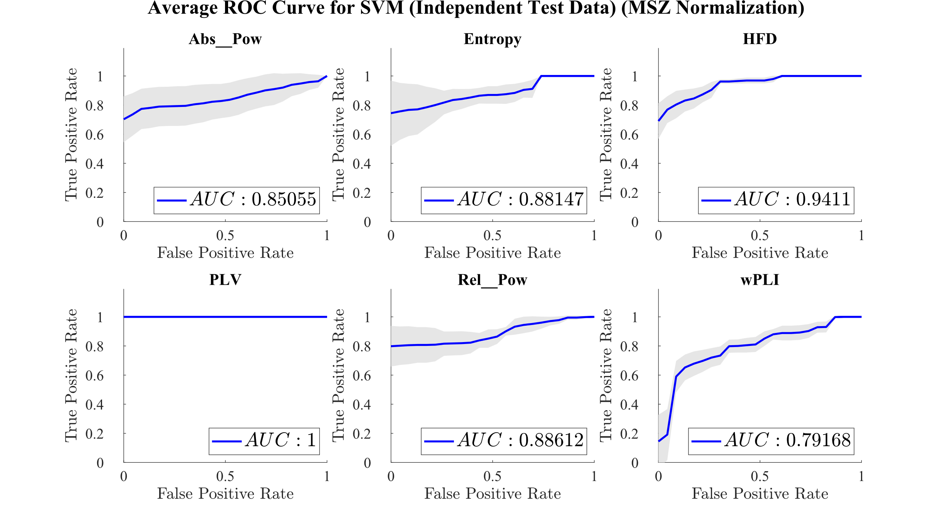

Slide 7
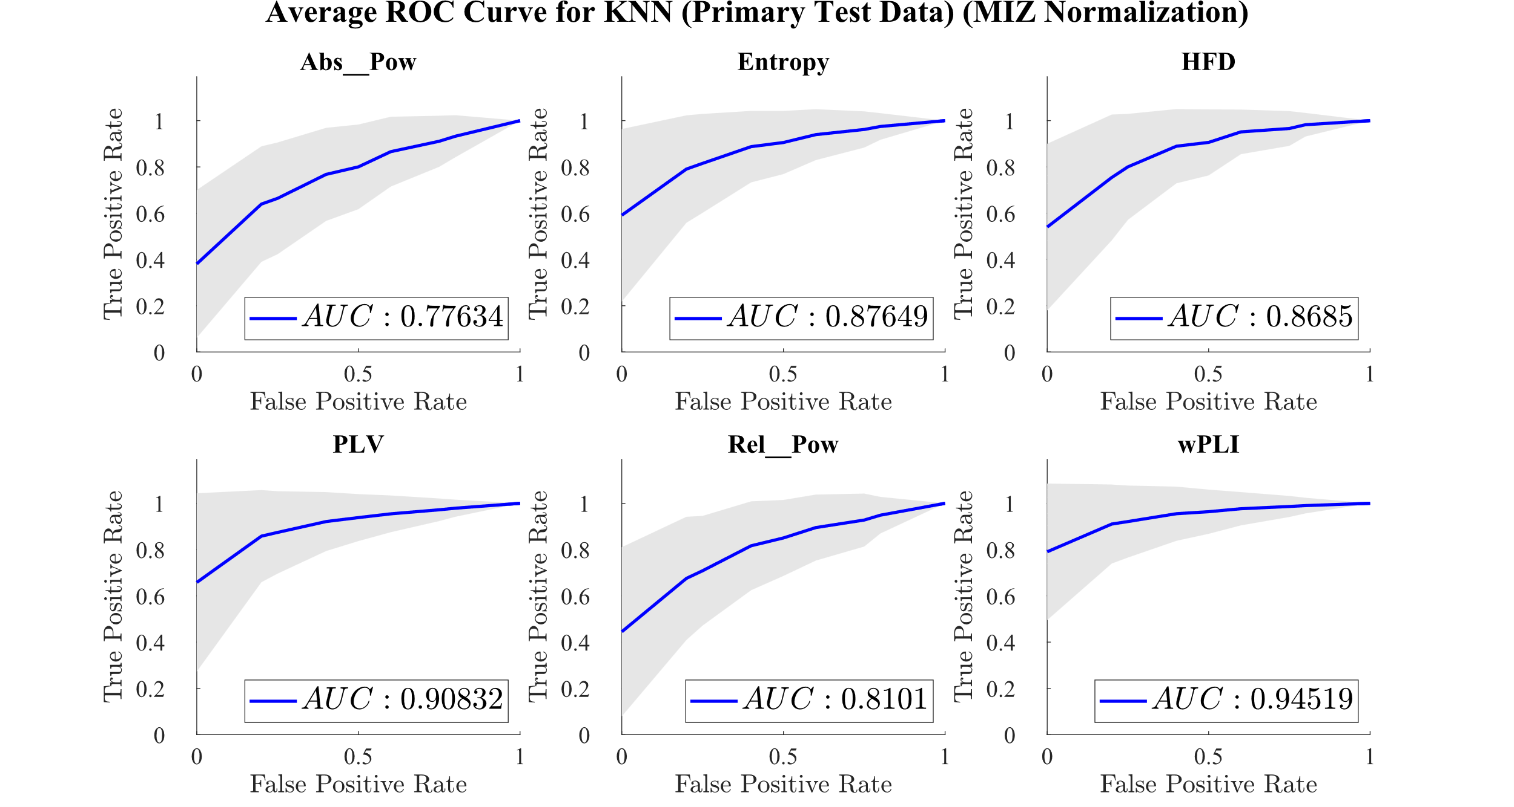
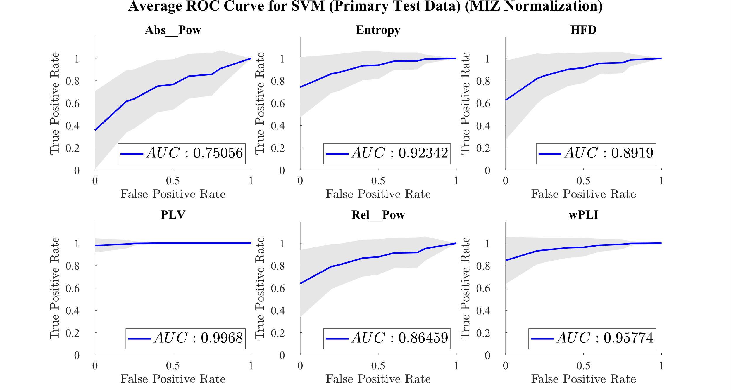

Slide 8
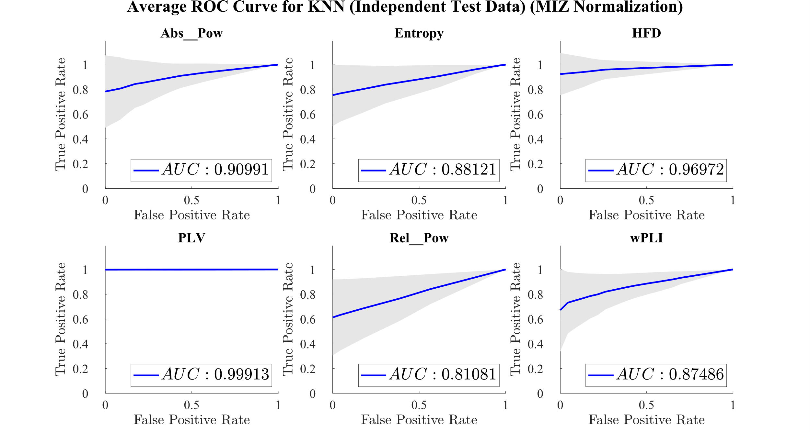
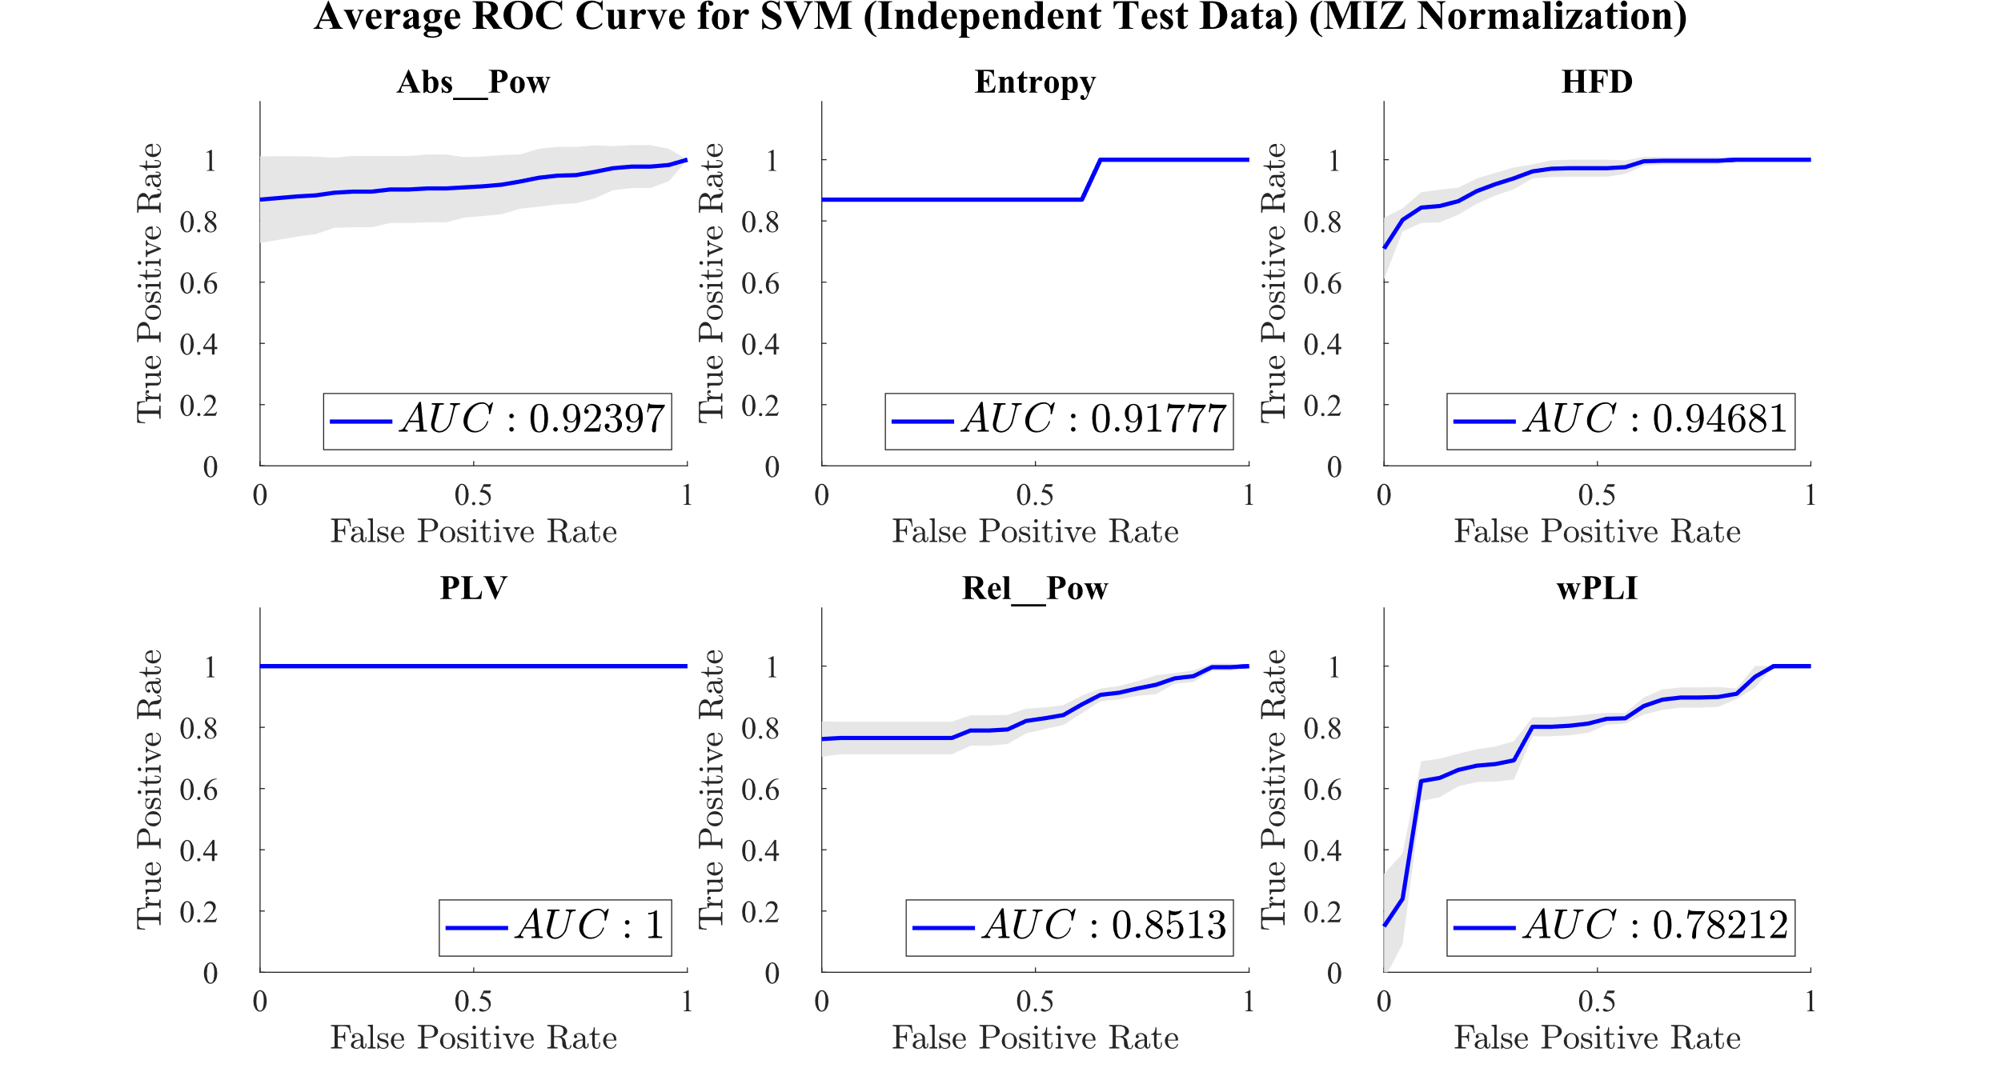

Slide 9
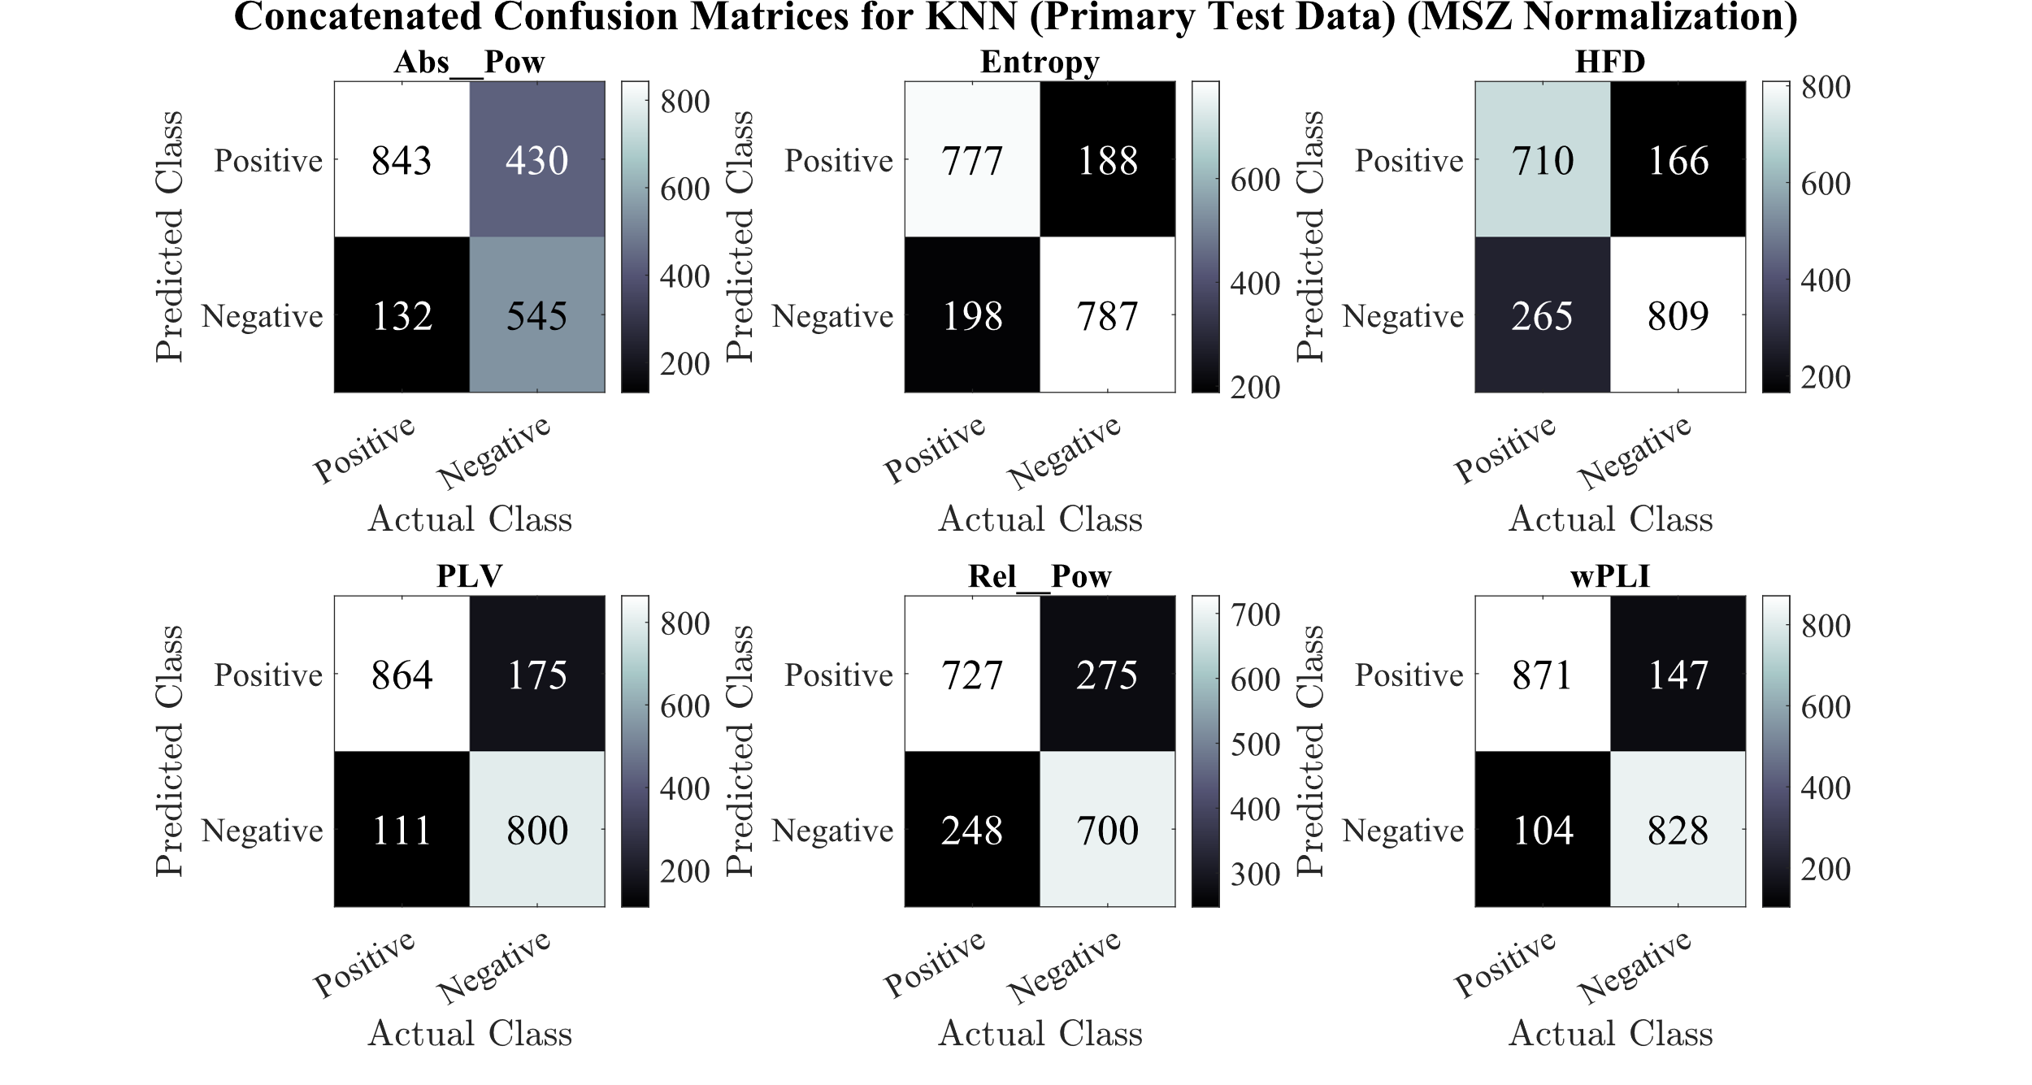
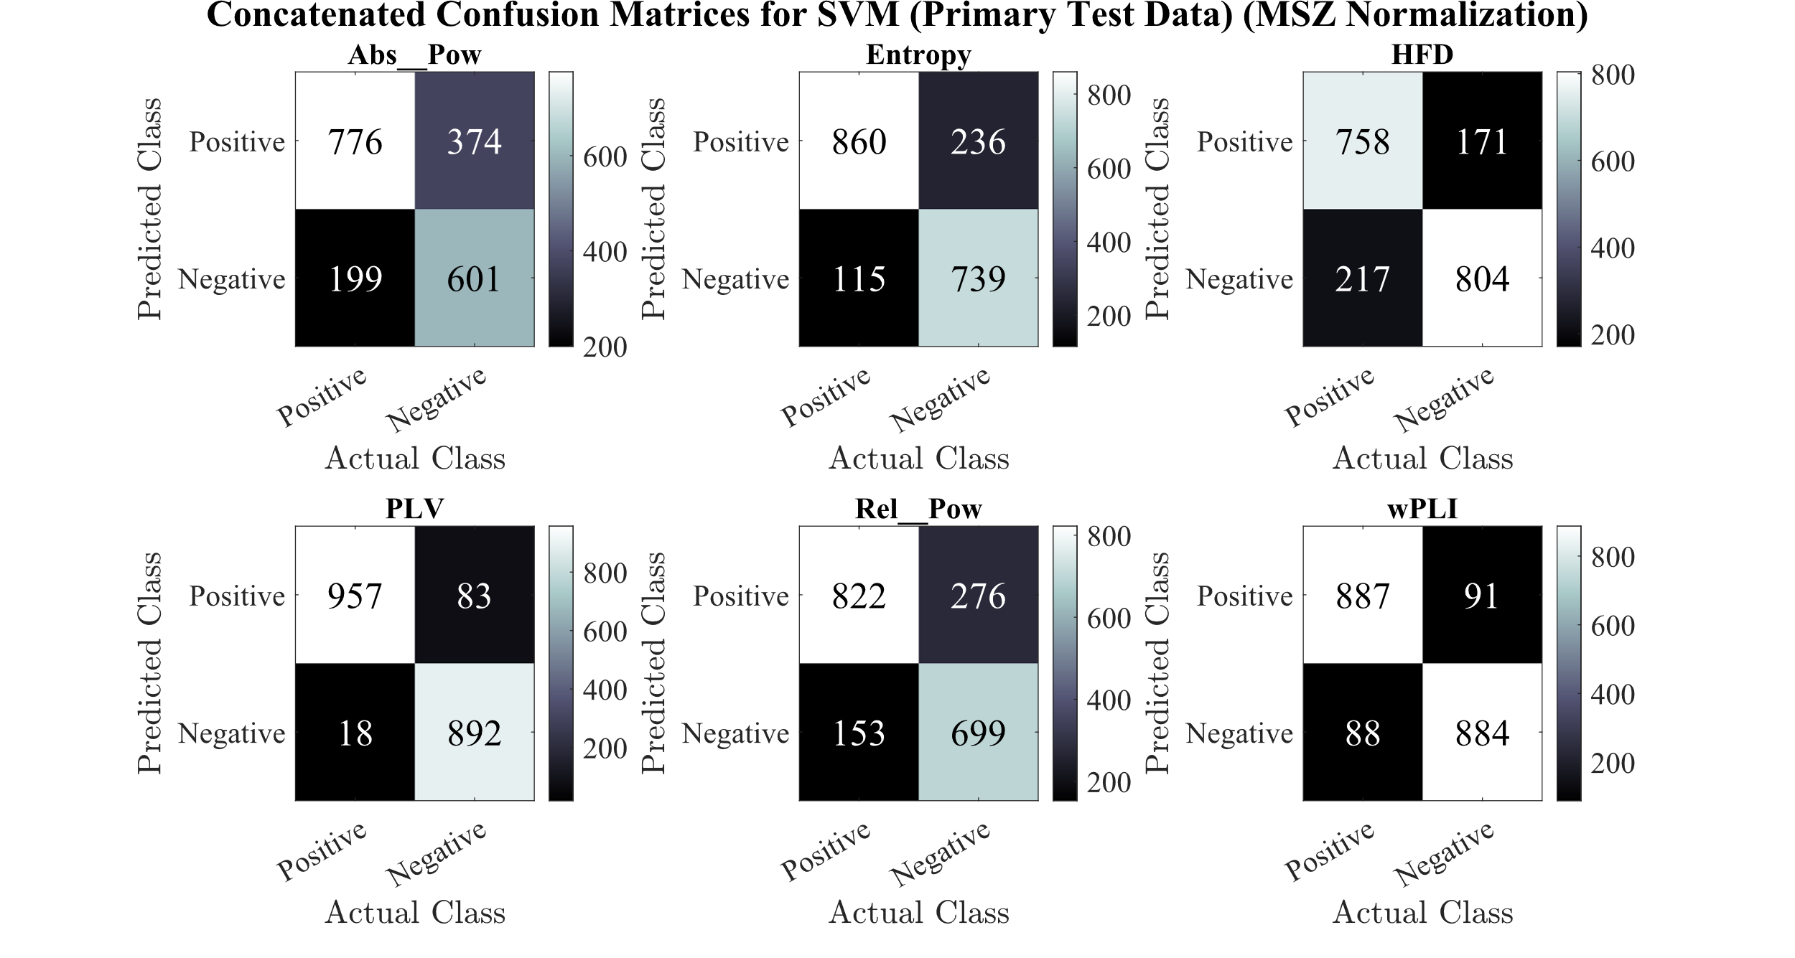

Slide 10
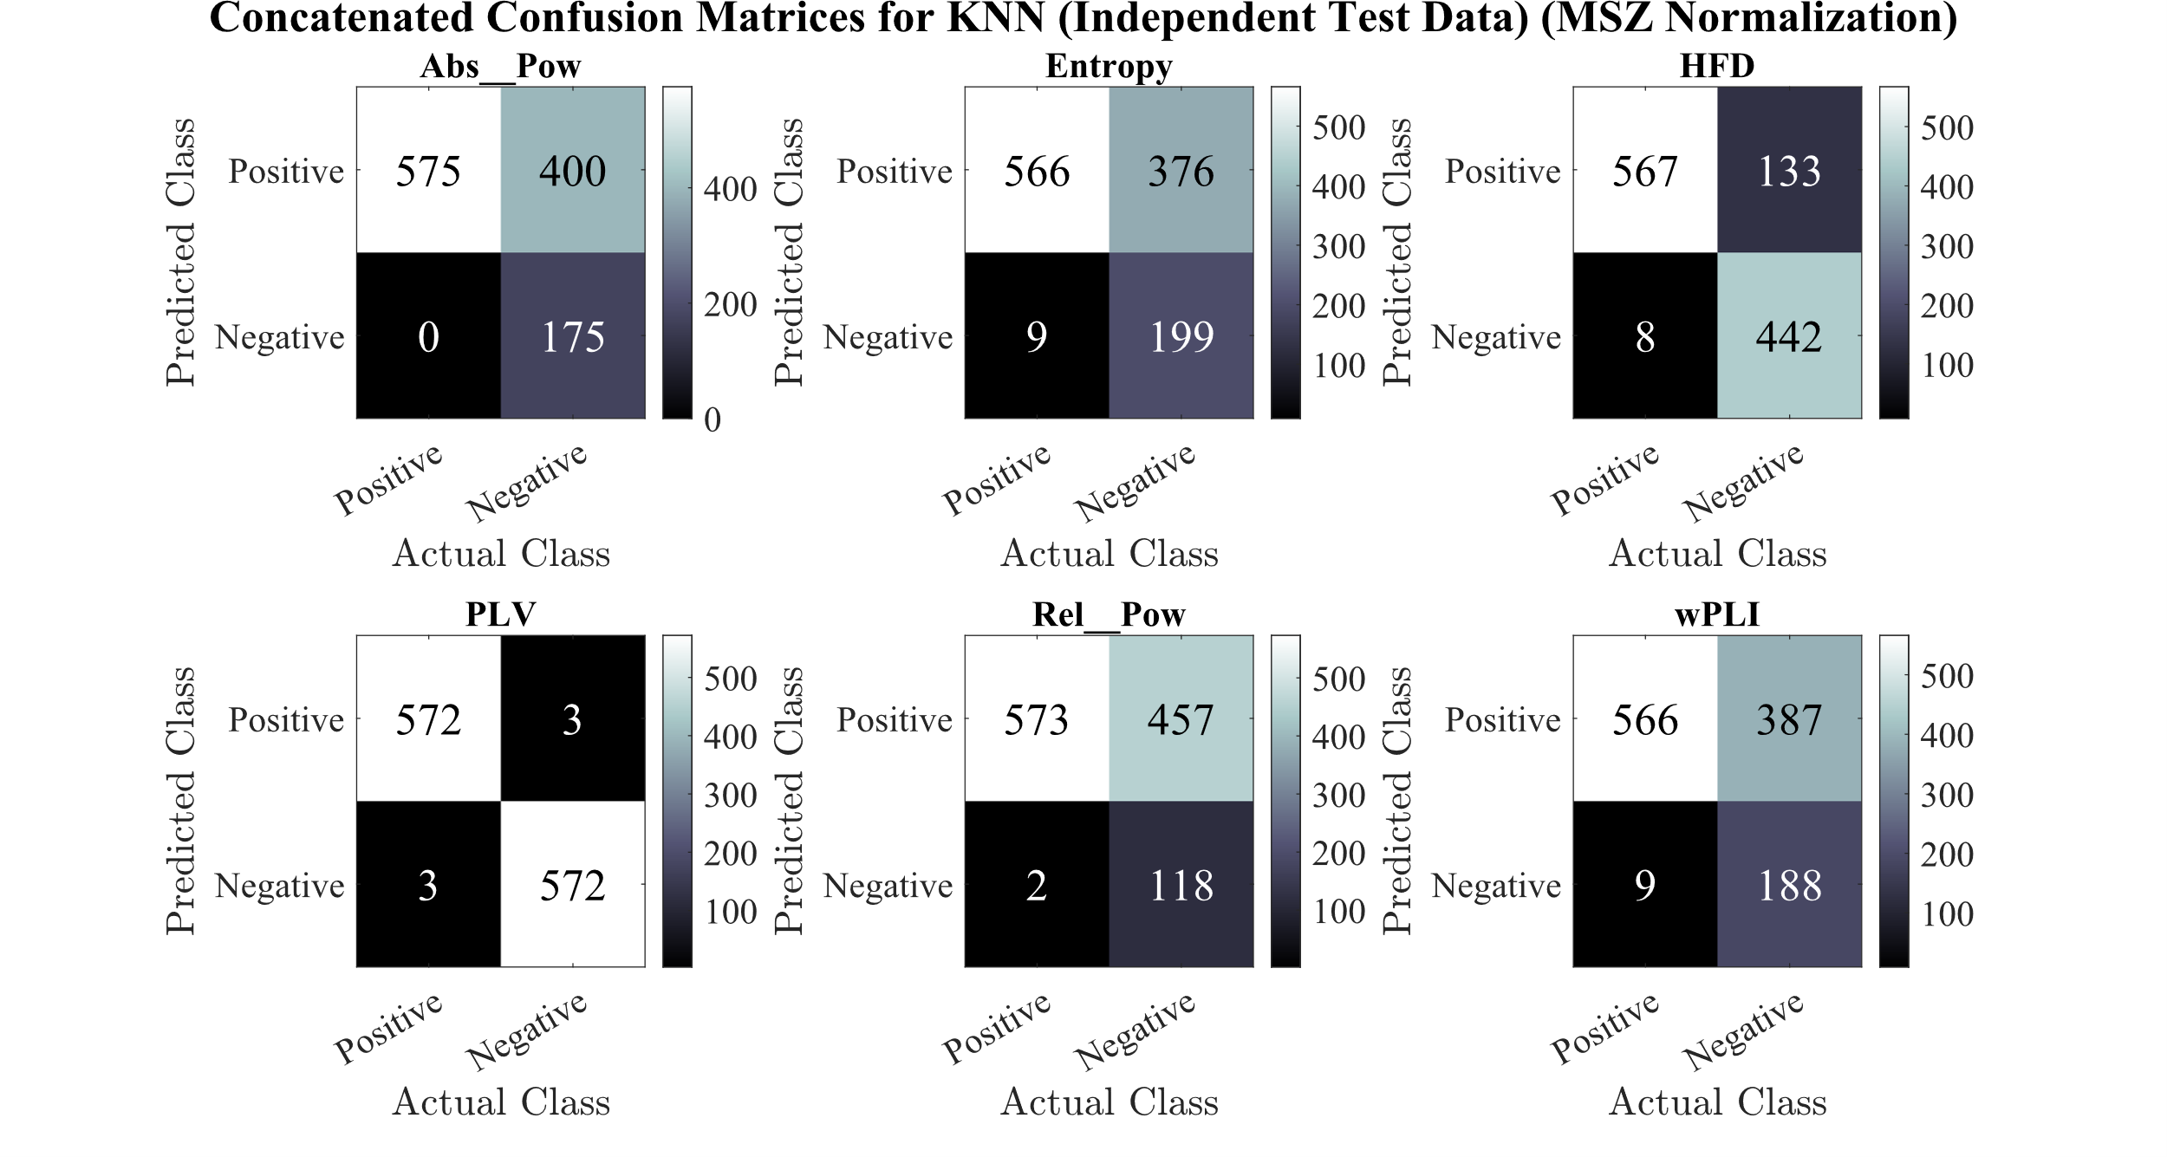
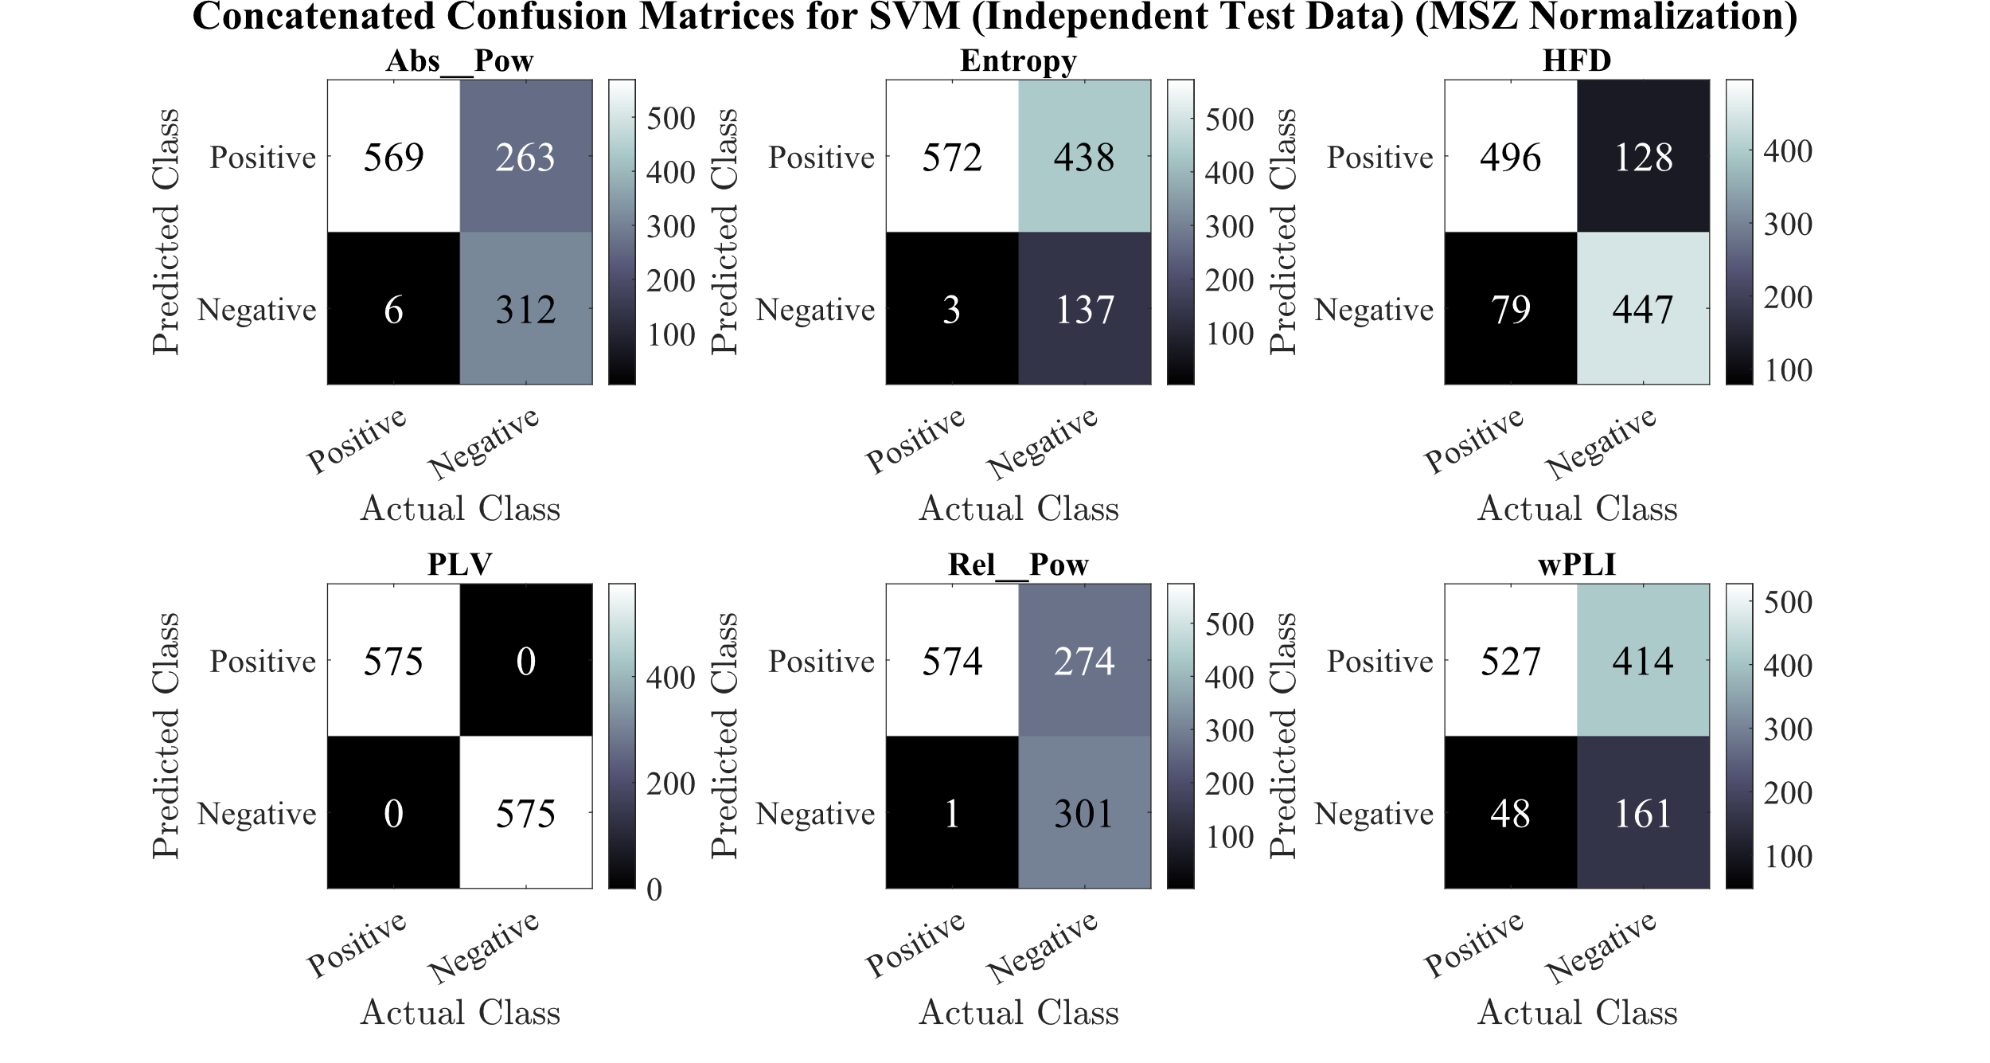

Slide 11
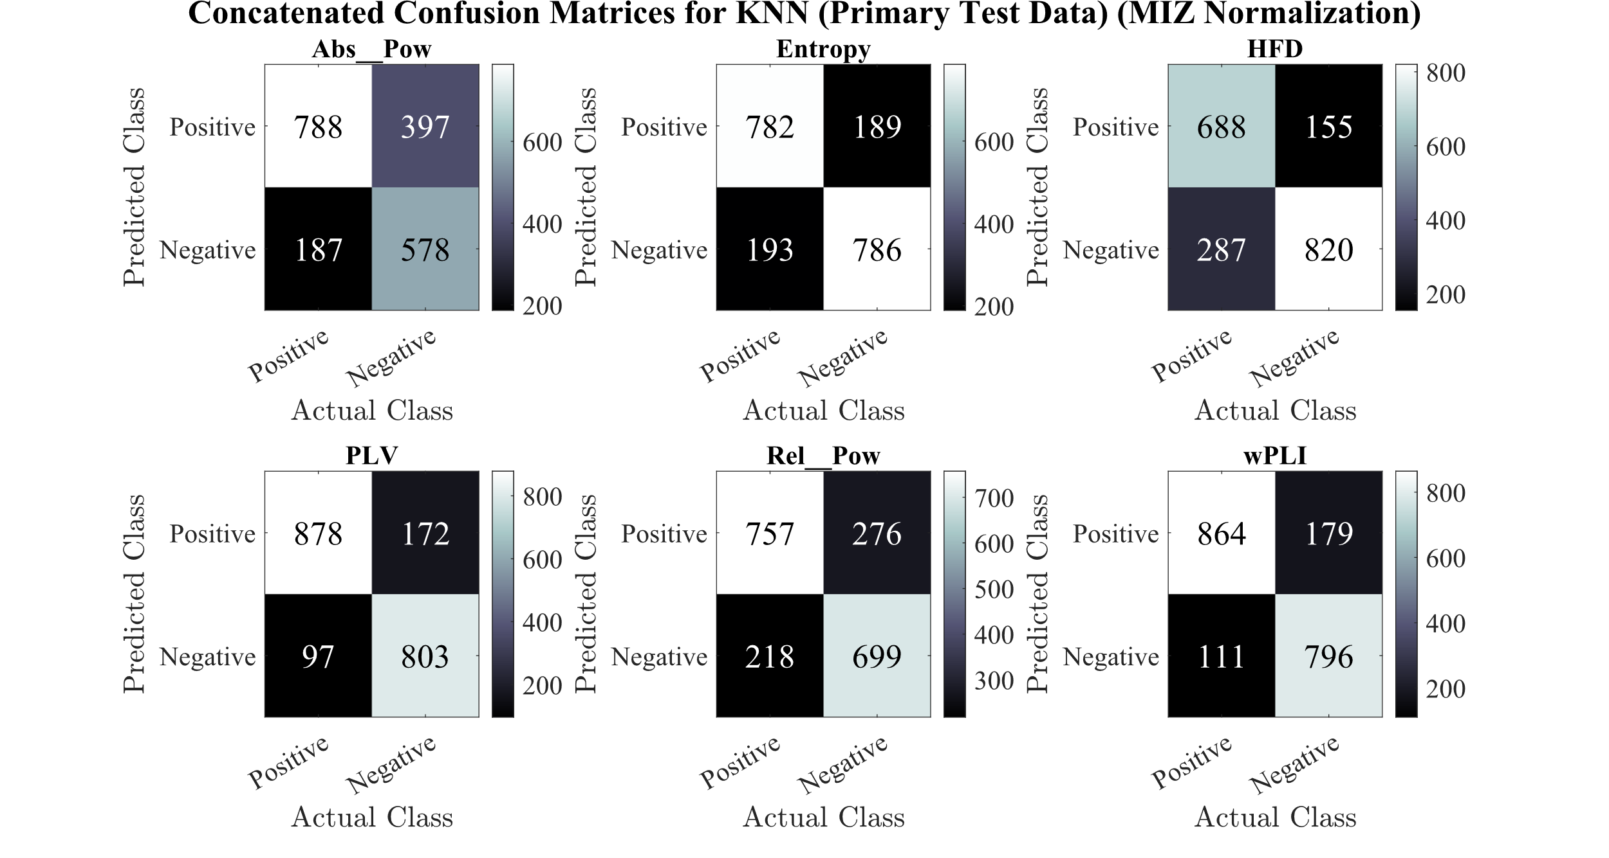
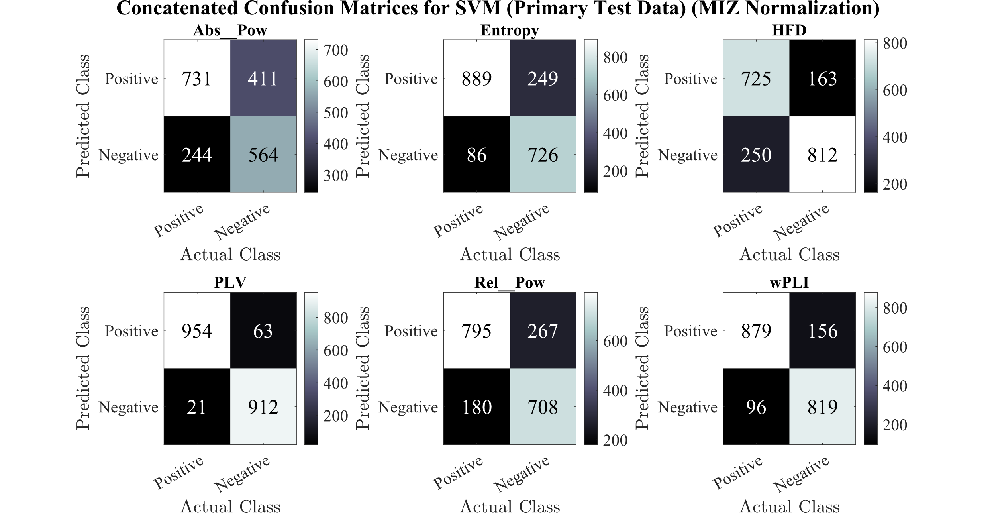

Slide 12
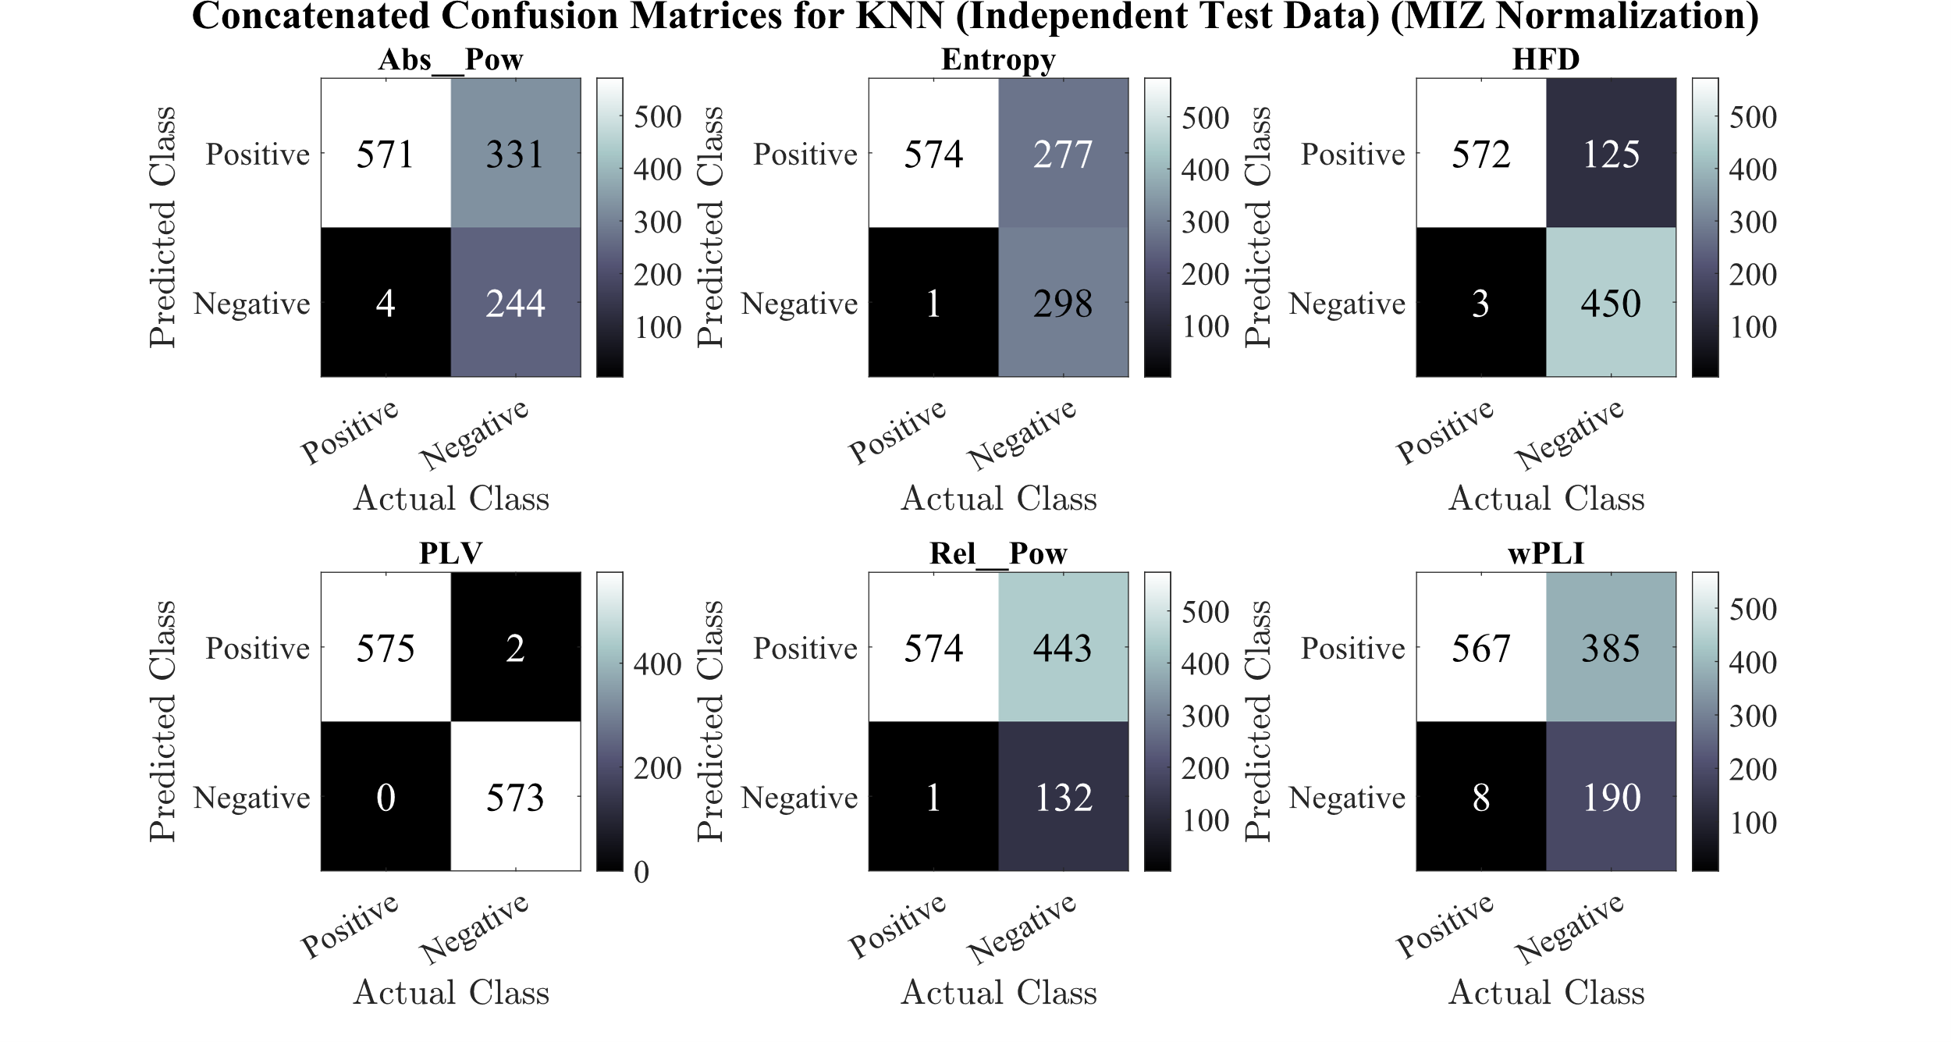
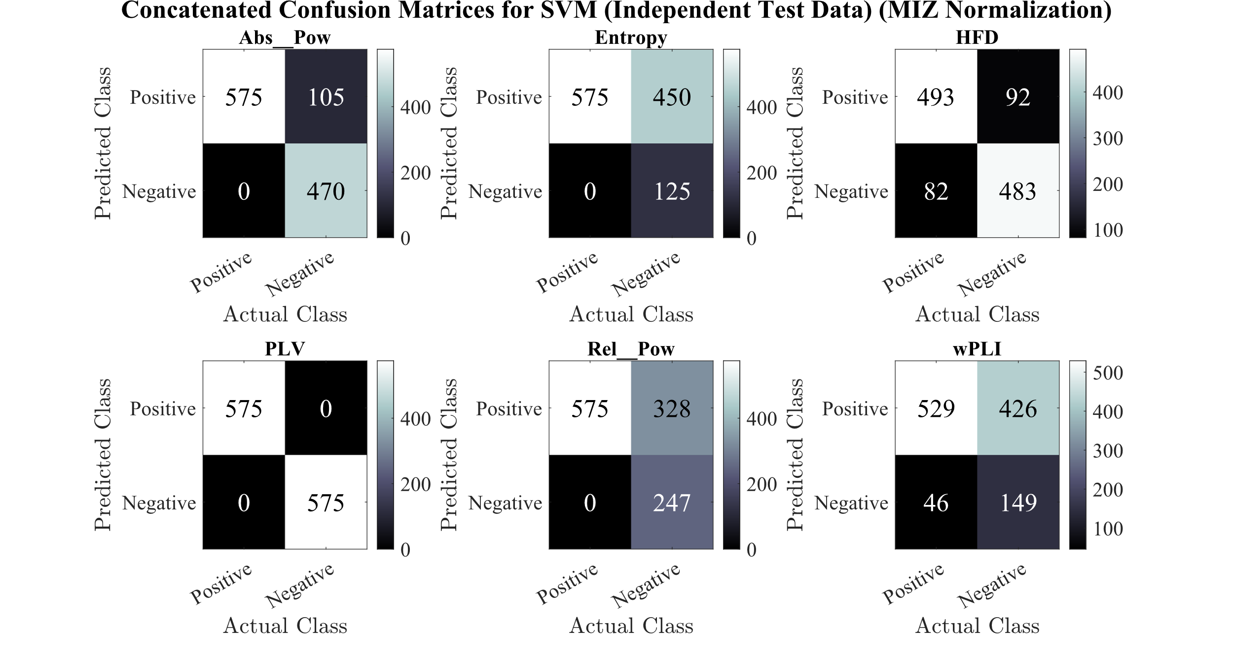

Slide 13
Alignments
Size of pictures:
Crop: 11.2 – 6.5 – 1 – 0.5
Resize: Lock Aspect Ratio – Height: 3.9
Positioning Pictures:
Left Pic: Horizontal: 0 – Vertical: 1.8
Right Pic: Horizontal: 6.81 – Vertical: 1.8

